Slide 1
Campus Recruitment Training (CRT)
Web Development
HTML + CSS + JavaScript

Slide 2
1. Introduction to HTML: Tags, elements, and structure
HTML stands for Hyper Text Markup Language
HTML is the standard markup language for creating Web pages
HTML describes the structure of a Web page
HTML consists of a series of elements
HTML elements tell the browser how to display the content
HTML elements label pieces of content such as "this is a heading", "this is a paragraph", "this is a link", etc.

Slide 3
1. Introduction to HTML: Tags, elements, and structure
A Simple HTML Document (Home Page)
<!DOCTYPE html> <html> <head> <title>Page Title</title> </head> <body> <h1>My First Heading</h1> <p>My first paragraph.</p> </body> </html>

Slide 4
2. HTML Document Structure: Head, body, and doctype
The <!DOCTYPE html> declaration defines that this document is an HTML5 document
The <html> element is the root element of an HTML page
The <head> element contains meta information about the HTML page
The <title> element specifies a title for the HTML page
(which is shown in the browser's title bar or in the page's tab)
The <body> element defines the document's body, and is a container for all the
visible contents, such as headings, paragraphs, images, hyperlinks, tables,
lists, etc.
The <h1> element defines a large heading
The <p> element defines a paragraph

Slide 5
3. Text Formatting: Headings, paragraphs, and emphasis
Formatting elements were designed to display special types of text:
<b> - Bold text
<strong> - Important text
<i> - Italic text
<em> - Emphasized text
<mark> - Marked text
<small> - Smaller text
<del> - Deleted text
<ins> - Inserted text
<sub> - Subscript text
<sup> - Superscript text
<pre> - Poem’s problem

Slide 6
3. Text Formatting: Headings, paragraphs, and emphasis
<q> tag defines a short quotation.
<abbr> tag defines an abbreviation or an acronym
<address> tag defines the contact information for the author/owner of a document
or an article.
<cite> tag defines the title of a creative work (e.g. a book, a poem, a song, a movie,
a painting, a sculpture, etc.).
<bdo> tag is used to override the current text direction:

Slide 7
3. Text Formatting: Headings, paragraphs, and emphasis
HTML Comment Tag
HTML comments are not displayed in the browser, but they can help document your HTML source code.
Notice that there is an exclamation point (!) in the start tag, but not in the end tag.
Hide Content
Comments can be used to hide content.
This can be helpful if you hide content temporarily:
Hide Inline Content
Comments can be used to hide parts in the middle of the HTML code.

Slide 8
4. Working with Links: Anchor tags and hyperlinks
HTML links are hyperlinks.
You can click on a link and jump to another document.
When you move the mouse over a link, the mouse arrow will turn into a little hand.

Slide 9
4. Working with Links: Anchor tags and hyperlinks
By default, links will appear as follows in all browsers:
An unvisited link is underlined and blue
A visited link is underlined and purple
HTML Links - The target Attribute
The target attribute specifies where to open the linked document.
_self - Default. Opens the document in the same window/tab as it was clicked
_blank - Opens the document in a new window or tab

Slide 10
4. Working with Links: Anchor tags and hyperlinks
Absolute URLs
An absolute URL - points to another web site
(like src="http://www.example.com/image.gif")
Relative URLs
A relative URL - points to a file within a web site
(like src="image.gif")
HTML Links - Use an Image as a Link
To use an image as a link, put the <img> tag inside the <a> tag:

Slide 11
5. Working with Images: Image tags and attributes
How to insert an image:
HTML Images Syntax
The HTML <img> tag is used to embed an image in a web page.
Images are not technically inserted into a web page; images are linked to web pages. The <img> tag creates a holding space for the referenced image.
The <img> tag is empty, it contains attributes only, and does not have a closing tag.
The <img> tag has two required attributes:
src - Specifies the path to the image
alt - Specifies an alternate text for the image

Slide 12
5. Working with Images: Image tags and attributes
Add Image border (with CSS)
How to insert images from another folder
From another web site
How to add a hyperlink to an image

Slide 13
6. Lists: Ordered and unordered lists
An unordered HTML list:
Item
Item
Item
An ordered HTML list:
First item
Second item
Third item

Slide 14
6. Lists: Ordered and unordered lists
Unordered HTML List - Choose List Item Marker
Value | Description
disc | Sets the list item marker to a bullet (default)
circle | Sets the list item marker to a circle
square | Sets the list item marker to a square
none | The list items will not be marked

Slide 15
6. Lists: Ordered and unordered lists
Ordered HTML List - The Type Attribute
Type | Description
type="1" | The list items will be numbered with numbers (default)
type="A" | The list items will be numbered with uppercase letters
type="a" | The list items will be numbered with lowercase letters
type="I" | The list items will be numbered with uppercase roman numbers
type="i" | The list items will be numbered with lowercase roman numbers

Slide 16
6. Lists: Ordered and unordered lists
Nested HTML Lists (list inside list)
Ordered
Unordered
Horizontal List (with CSS)

Slide 17
7. Tables: Creating tables and formatting data
HTML Table
How to right-align a table (with CSS)
How to add background-color to a table (with CSS)
How to add padding to a table (with CSS)
How to set table width (with CSS)
How to define table cells that span more than one row or one column

Slide 18
8. Forms: Form elements and input types
<input>
<label> and for attribute
<select> and <option>
<textarea>
<button>
<fieldset> and <legend>
<input type="button">
<input type="checkbox">
<input type="color">
<input type="date">
<input type="email">
<input type="file">
<input type="hidden">
<input type="image">
<input type="month">
<input type="number">
<input type="password">
<input type="radio">
<input type="range">
<input type="reset">
<input type="search">
<input type="submit">
<input type="text">
<input type="time">
<input type="week">

Slide 19
9. Form Validation: Client-side form validation
Form validation?
"This field is required" (You can't leave this field blank).
"Please enter your phone number in the format xxx-xxxx" (A specific data format is required for it to be considered valid).
"Please enter a valid email address" (the data you entered is not in the right format).
"Your password needs to be between 8 and 30 characters long and contain one uppercase letter, one symbol, and a number." (A very specific data format is required for your data).

Slide 20
9. Form Validation: Client-side form validation
Why we need to validate a form:
We want to get the right data, in the right format.

Slide 21
9. Form Validation: Client-side form validation
Built-in form validation
required attribute
type attribute
pattern attribute
min, max attribute
minlength, maxlength attribute

Slide 22
10. Multimedia: Audio and video elements
Insert <video> in a webpage
<video controls>
<source src="video/mov_bbb.mp4" type="video/mp4">
</video>
Insert <audio> in a webpage
<audio controls>
<source src="audio/horse.mp3" type="audio/mp3">
</audio>
Insert <iframe> in a webpage
<iframe height="300" width="500“ src="https://www.youtube.com/embed/tgbNymZ7vqY" title="">
</iframe>

Slide 23
Cascading Style Sheets (CSS)

Slide 24
11. Introduction to CSS
What is CSS?
CSS stands for Cascading Style Sheets.
Cascading Style Sheets (CSS) is used to format the layout of a webpage.
CSS saves a lot of work. It can control the layout of multiple web pages all at once.
CSS can be added to HTML documents in 3 ways:
(1) Inline (2) Internal (3) External

Slide 25
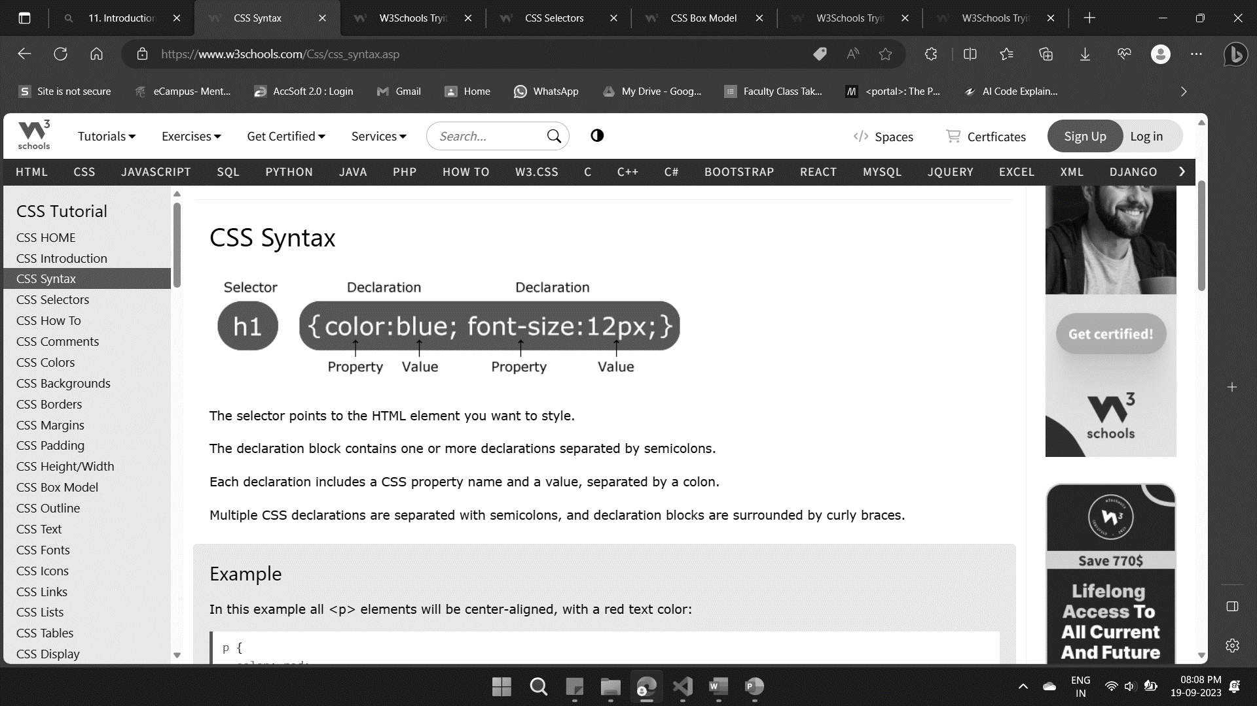
11. Introduction to CSS: Syntax

Slide 26
11. Introduction to CSS: selectors
Simple selectors (select elements based on name, id, class)
Based on name
Based on id
Based on class

Slide 27
11. Introduction to CSS: selectors
2. Combinator selectors
descendant selector (space): div p {background-color: yellow;}
child selector (>): div > p {background-color: yellow;}
adjacent sibling selector (+): div + p {background-color: yellow;}
general sibling selector (~): div ~ p {background-color: yellow;}

Slide 28
11. Introduction to CSS: selectors
3. Pseudo-class selectors
Anchor Pseudo-classes
a:hover {
color: #FF00FF;
}
Hover on <div>
div:hover {
background-color: blue; }

Slide 29
11. Introduction to CSS: selectors
4. Pseudo-elements selectors
The ::first-line Pseudo-element
p::first-line { color: #ff0000; font-variant: small-caps; }
The ::first-letter Pseudo-element
p::first-letter { color: #ff0000; font-size: xx-large; }

Slide 30
11. Introduction to CSS: selectors
5. Attribute selectors
Styling Forms
input[type="text"] { width: 150px; display: block; margin-bottom: 10px; background-color: yellow; }
input[type="button"] { width: 120px; margin-left: 35px; display: block; }

Slide 31
11. Introduction to CSS: CSS Comments
CSS Comments
Comments are used to explain the code, and may help when you edit the source code at a later date.
Comments are ignored by browsers.
A CSS comment is placed inside the <style> element, and starts with /* and ends with */:

Slide 32
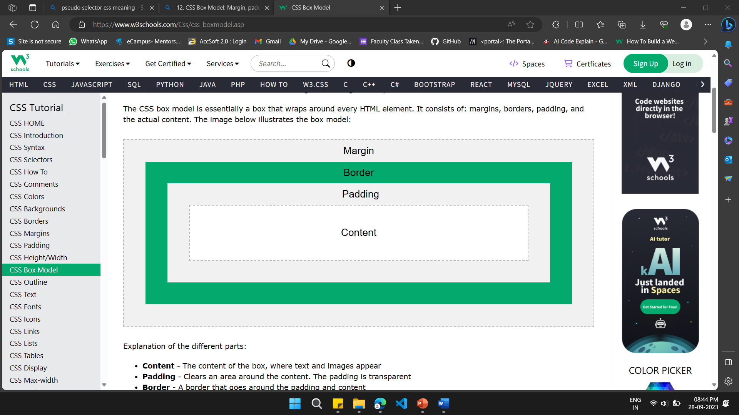
12. CSS Box Model: Margin, padding, and border
The CSS Box Model

Slide 33
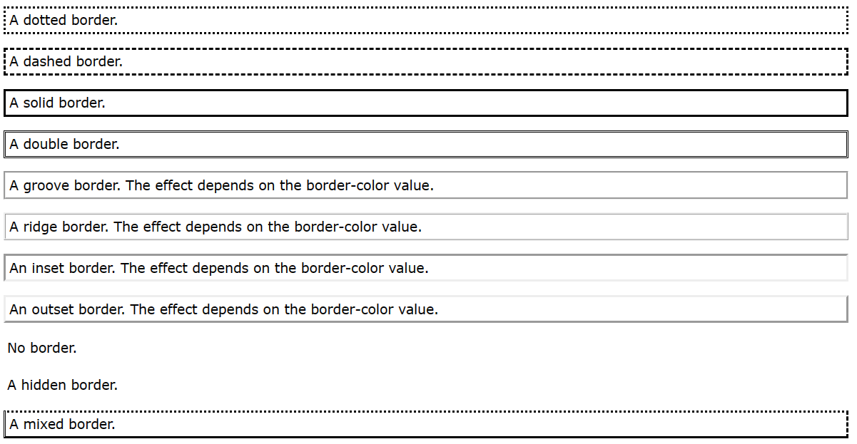
12. CSS Box Model: border

Slide 35
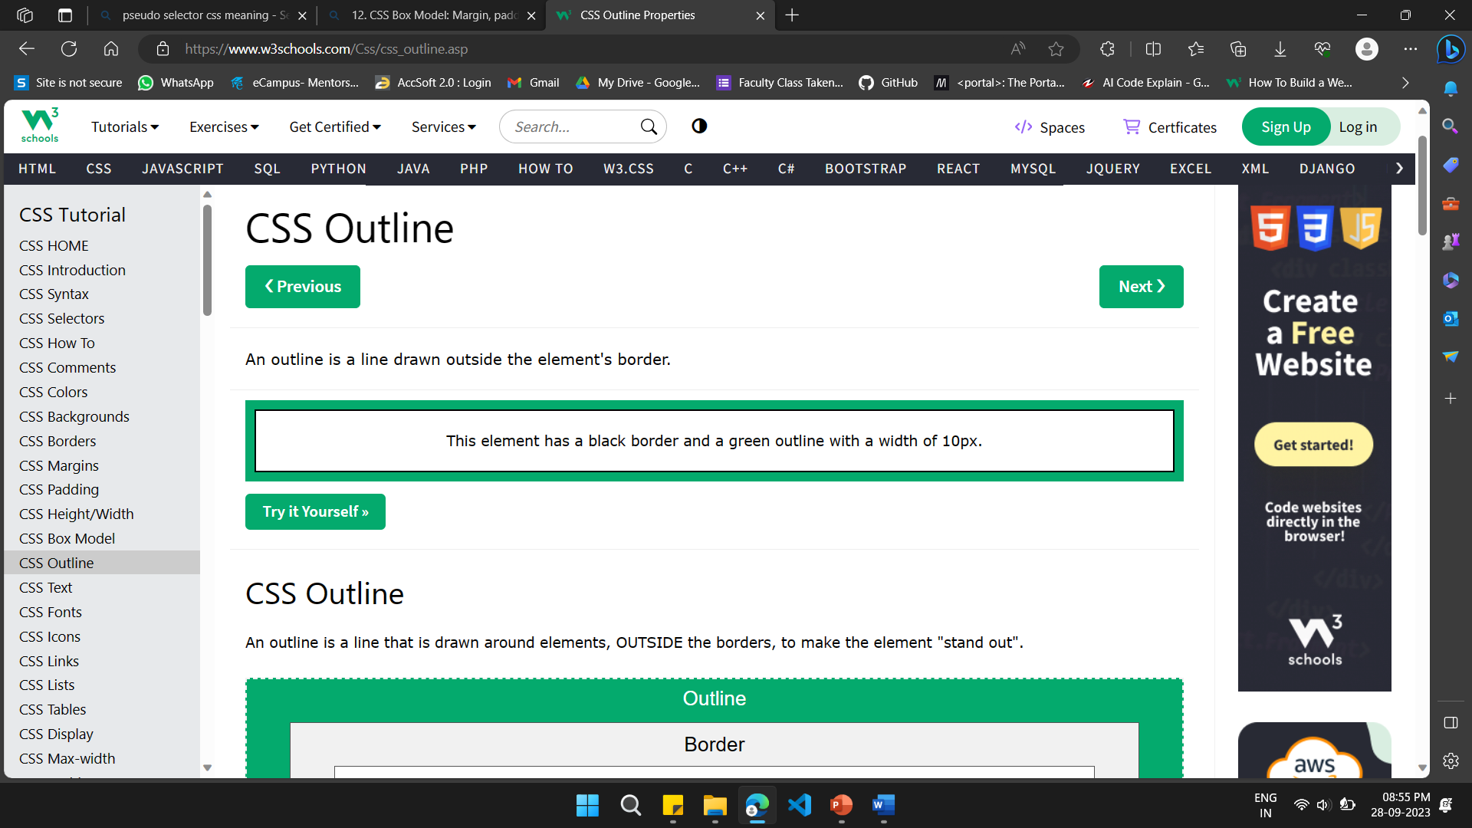
12. CSS Box Model: CSS Outline

Slide 36
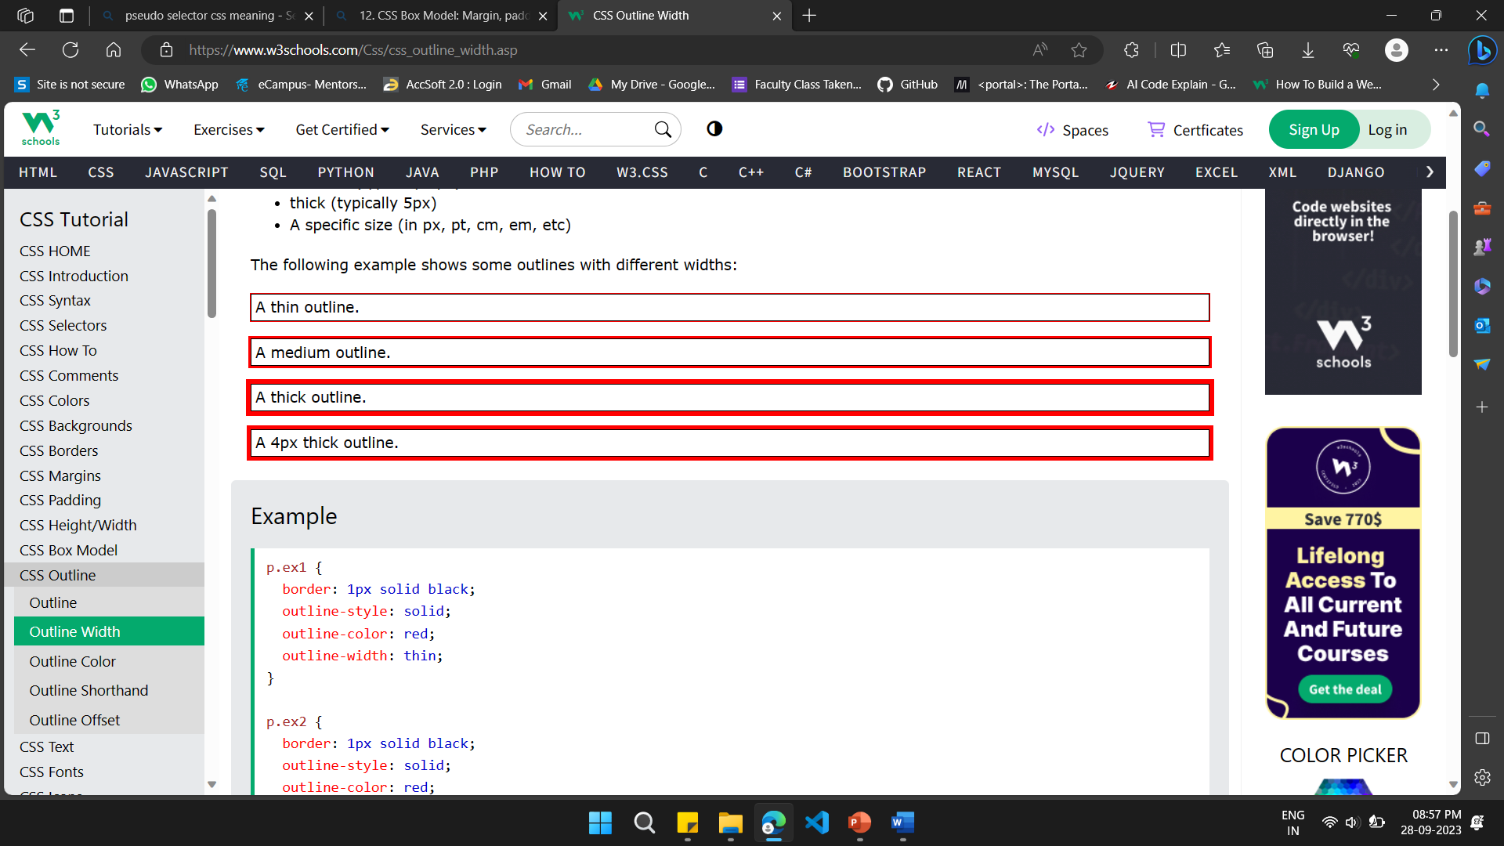
12. CSS Box Model: CSS Outline Width

Slide 37
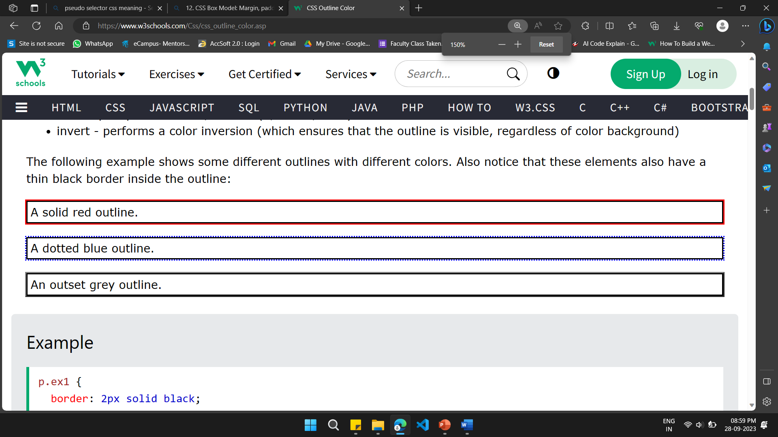
12. CSS Box Model: CSS Outline Color

Slide 38
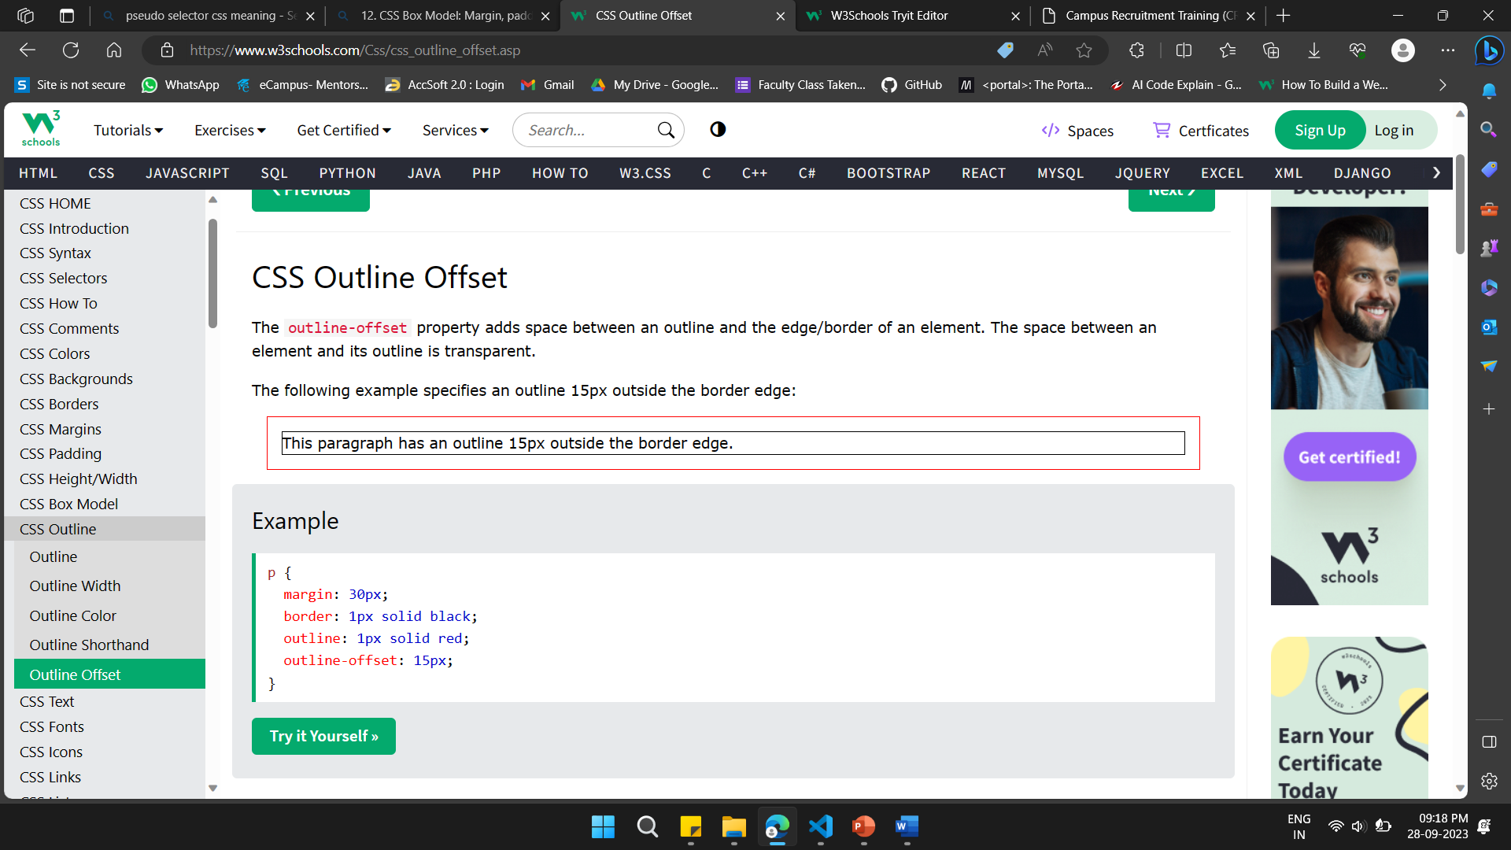
12. CSS Box Model: CSS Outline Offset

Slide 39
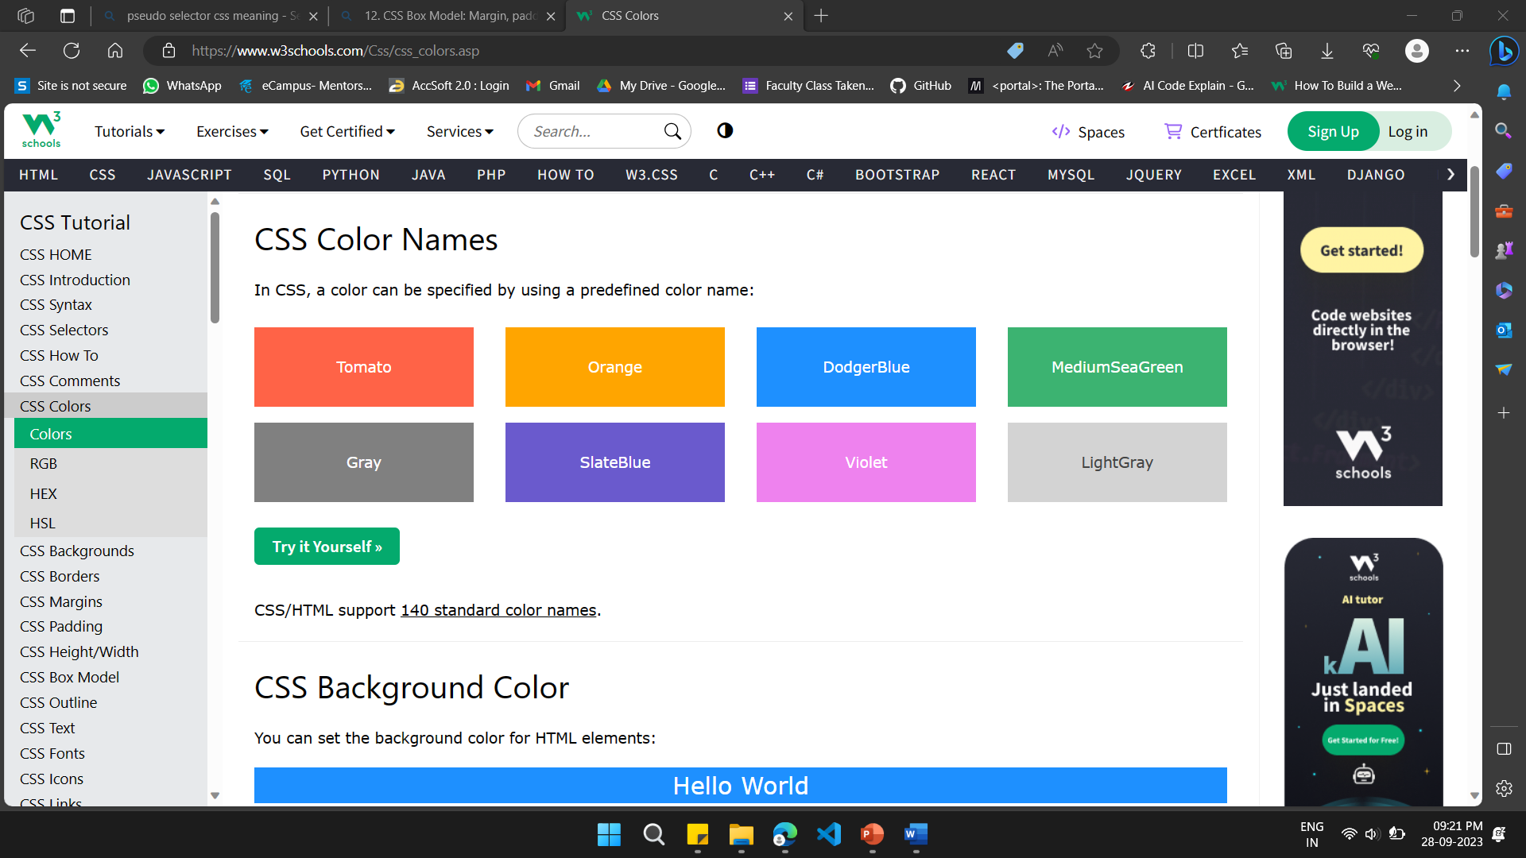
13. Working with Colors: Color Names

Slide 40
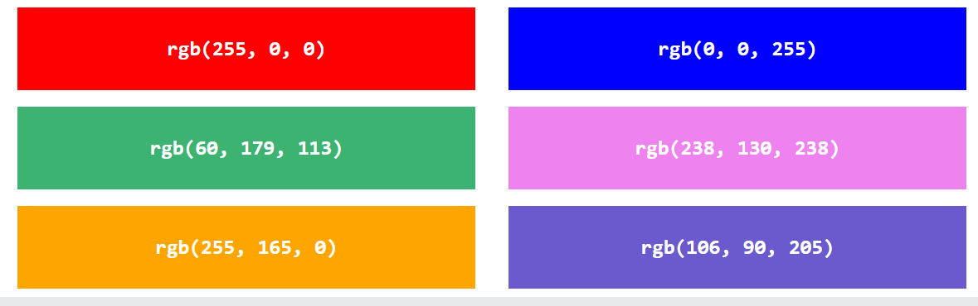
13. Working with Colors: CSS RGB Colors

Slide 41
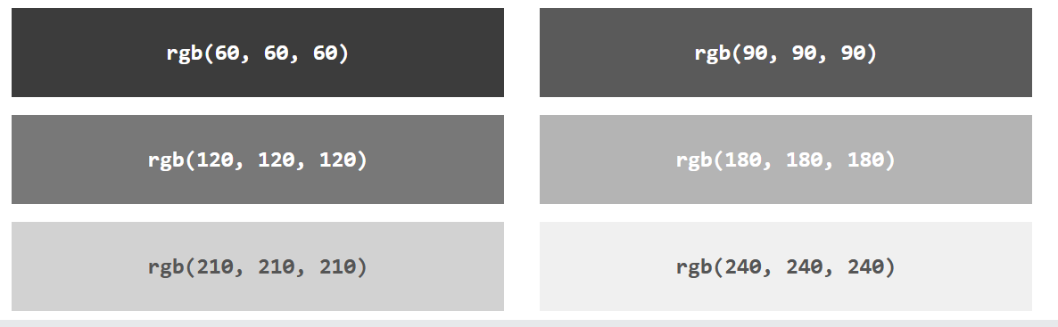
13. Working with Colors: Shades of Gray (RGB)

Slide 42
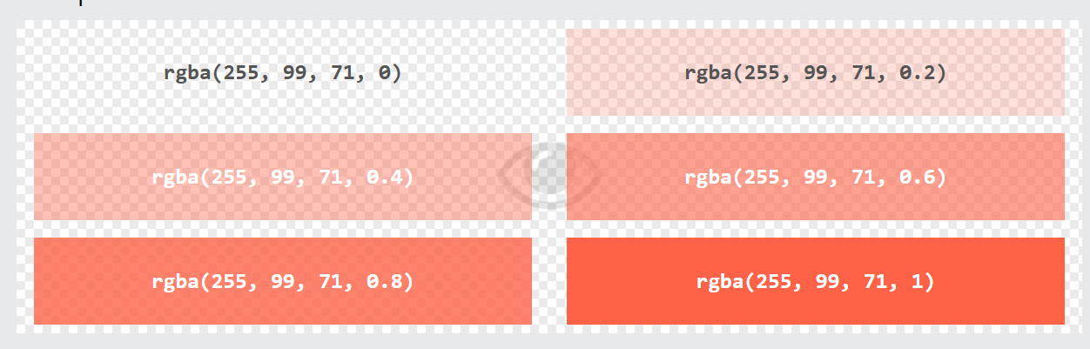
13. Working with Colors: RGBA Value

Slide 43
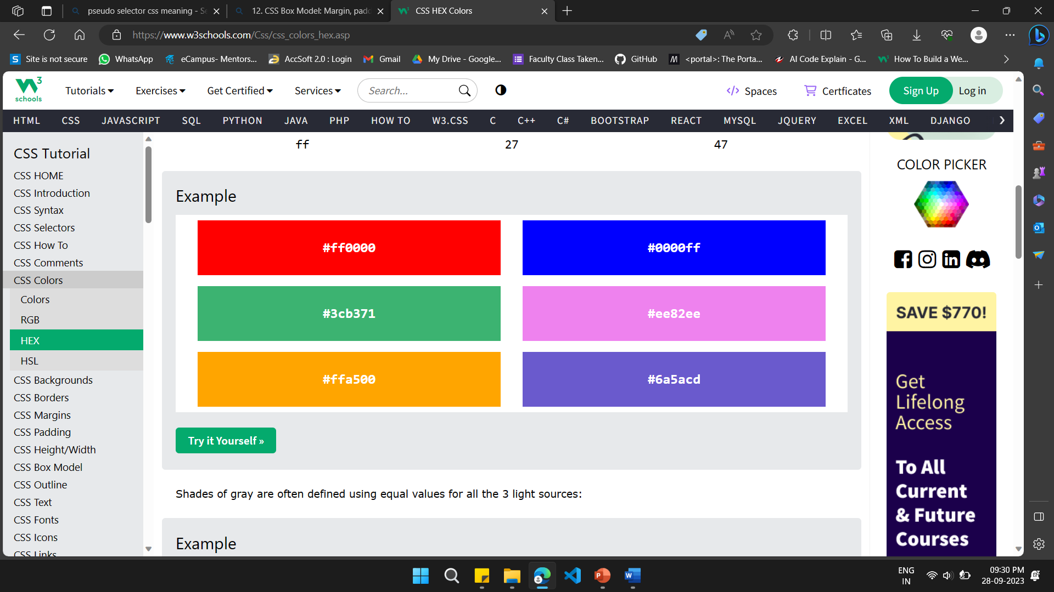
13. Working with Colors: HEX Colors

Slide 44
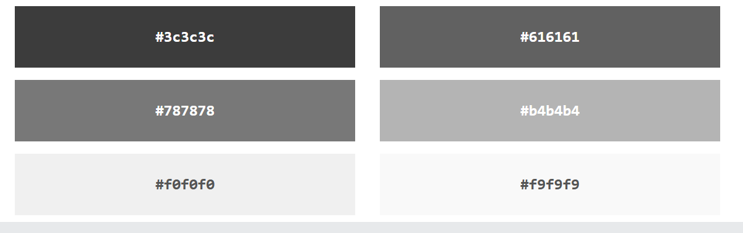
13. Working with Colors: Shades of Gray (HEX)

Slide 45
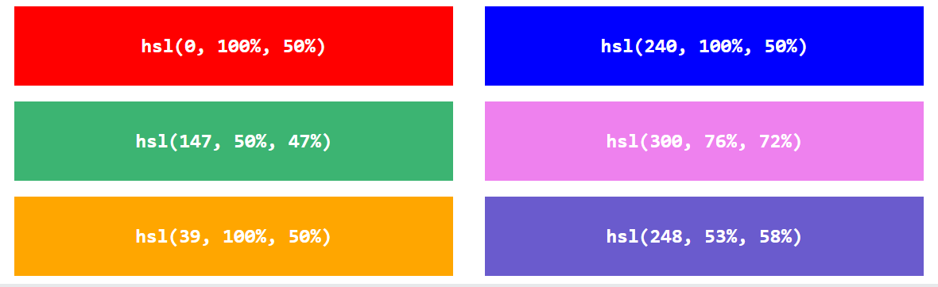
13. Working with Colors: CSS HSL Colors

Slide 46
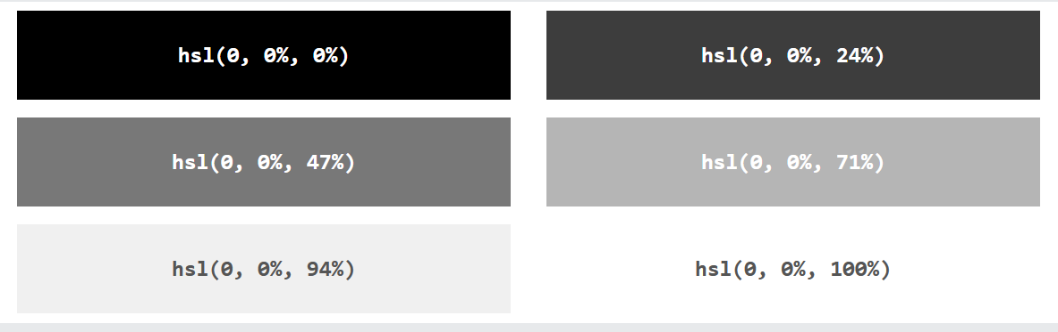
13. Working with Colors: Shades of Gray (HSL)

Slide 47
14. CSS Text Styling: Font properties and text formatting

